Slide 1
CPU Performance Monitoring Tool
By: Mustak

Slide 2
Contents
Communication between Uart, PC and embedded board
Understanding what is CPU load
Method to calculate CPU load
Architecture
Modifications to de done in code

Slide 3
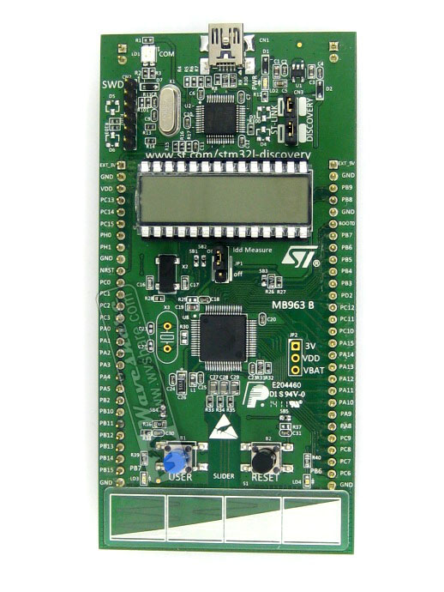
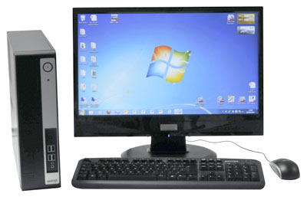
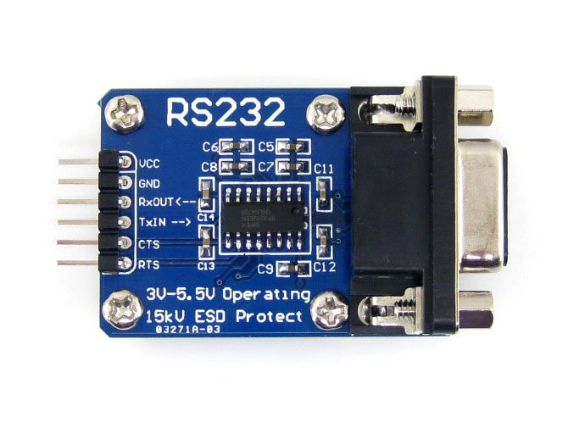
Communication between embedded board, Uart and PC
y
i
s
3
\n
s
e
P
1
Embedded board
Uart board
PC

Slide 4
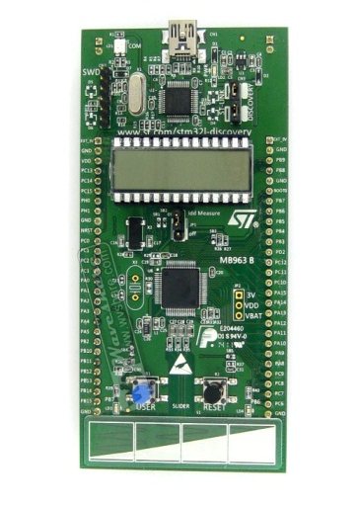
s
e
y
i
s
R
1
3
\n
buffer
i
s
R
1
void main()
{ while (1) { if ( newLineRecived) {
ans=chkPrime (buffer) newLineRecived = 0 ; }
}
}
3
\n
void Uart_ISR()
{ buffer[cnt++] = DR ; if (DR == \n)
newLineRecived = 1; }

Slide 5

Calculation of CPU load
CPU load in percentage is calculated by using formula
$CPU load=(1−\left(\frac{TimeSpentInInfiniteLoop}{TotalTime}\right))×100$
TimeSpentIninfineLoop is in m.sec.
TotalTime is 1 second i.e. 1000m.sec.

Slide 6

$$CPU load=(1−\left(\frac{TimeSpentInInfiniteLoop}{TotalTime}\right))×100$$
void mainLoop()
{
while(1)
{
if(flag==1)
{
usrCmd();
flag=0;
}
}
}
void usrCmd()
{
..
..
..
..
..
..
..
}
void timeISR(void)
{
if(PC lies in mainLoop)
{
idle++;
}
}

Slide 7
How context is stored
Stack
00045656
void mainLoop()
{
while(1)
{
if(flag==1)
{
usrCmd();
flag=0;
}
}
}
0x1000
0x1002
0x1004
0x1005
0x1007
0x1009
0x100C
0x100E
void usrCmd()
{
..
..
..
..
..
..
..
}
0x2000
0x2002
0x2004
0x2005
0x2007
0x2009
void timeISR(void)
{
read PC from stack
if(PC is in mainLoop)
{
idle++;
}
}
00001106
SP
00047010
00001306
00125001
00000001
00007991
00001201
00000001
00000000
00000001
00002004
00001002
00001004
00001456
00001302
SP
00000100

Slide 8
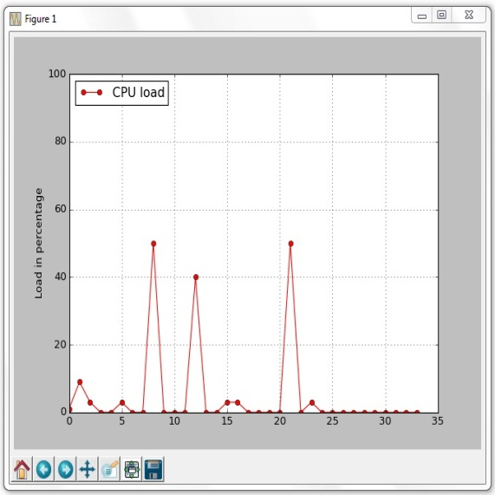
Architecture
User input
Infinite loop
UART ISR
Other ISRs
User cmd
functions
User cmd
thread
Plot graph thread
Timer ISR
UART ISR
CPU load function
CPU load thread
Target Program
Python script
GUI (graph)

